Slide 1

Session 2: Through the lens of Doncaster’s Older Residents

Slide 2
Local Context
Data

Slide 3

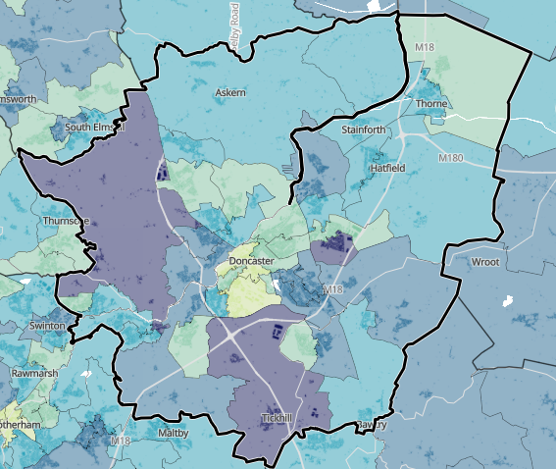
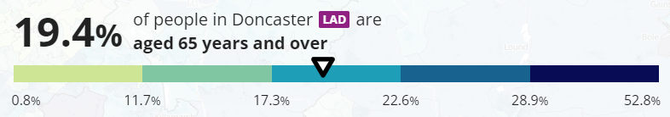
Population
The 2021 census found that Doncaster had 59,867 (19.4%) people aged 65+ living in the borough.
% of Doncaster Residents Aged 65+ by MSOA
Tickhill & Wadworth | 33.7% | Hatfield West | 19.1%
Cadeby, Hickleton & Hampole | 29.8% | Stainforth | 18.55
Armthorpe South | 29.8% | Mexborough East | 18.1%
Kirk Sandall & Barnby Dunn | 27.2% | Conisbrough South | 17.8%
Old Cantley, Auckley & Finningley | 26.1% | Bawtry, Austerfield & Hayfield | 17.7 %
Bessacarr & Bawtry Road | 25.9% | Scawthorpe | 17.7%
Bessacarr Grange & Lakeside | 23.9% | Bentley Rise | 17.7%
Sprotbrough | 23.8% | Mexborough West | 17.3%
Rossington | 23.7% | Wheatley Hills | 17%
Warmsworth, Braithwell & Stainton | 23.6% | Armthorpe North | 16%
Cusworth | 22.9% | Intake | 15.9%
Cantley Park | 22.8% | Belle Vue & Town Fields | 15.3%
Carcroft | 22.5% | Adwick Le Street & Woodlands | 15.2%
Thorne | 22.2% | Moorends | 15.1%
Edenthorpe & Mere Lane | 21.5% | New Rossington | 15.1%
Hatfield East | 21.4% | Bentley & Toll Bar | 14.4%
Conisbrough North | 19.9% | Balby Carr | 10%
Balby South | 19.8% | Central Doncaster & Hyde Park | 9.1%
Askern | 19.5%

Slide 4
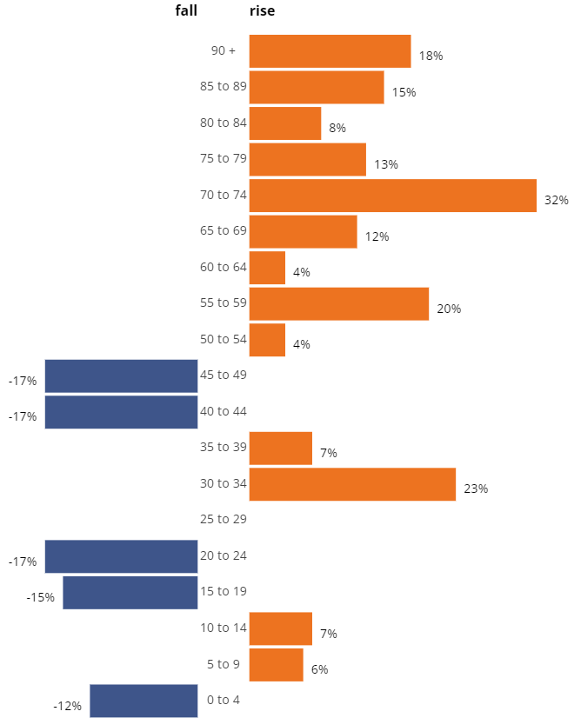
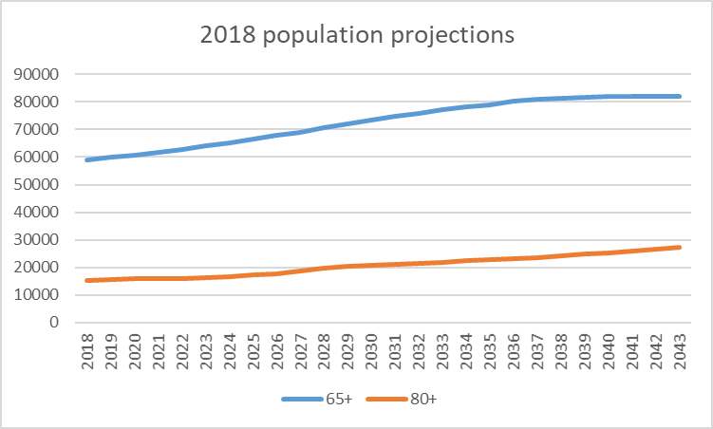
Population Change
Population change (%) by age group in Doncaster, 2011 to 2021
It is estimated that by 2036 Doncaster will have over 80,000 residents aged over 65
This data is based on the 2018 population projections, and will certainly be rebased In the light of the 2021 census.
The expectation is that, on average, the number of people aged 65+ will increase by around 1200 each year, and around 650 a year for people aged 85+.
increase in people aged 65 years and over
decrease in people aged 15 to 64 years
decrease in children aged under 15 years.

Slide 5
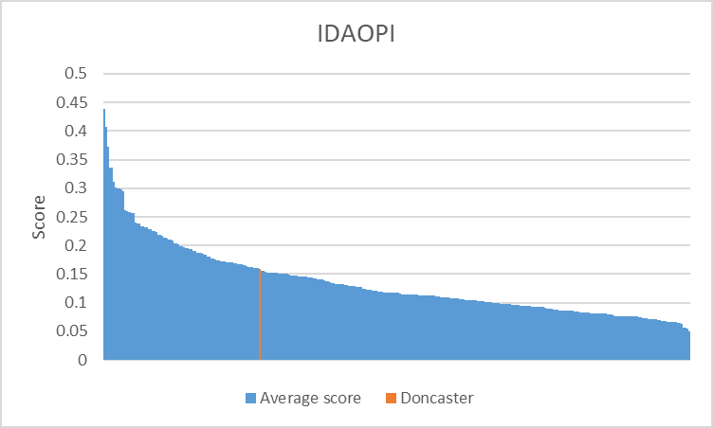
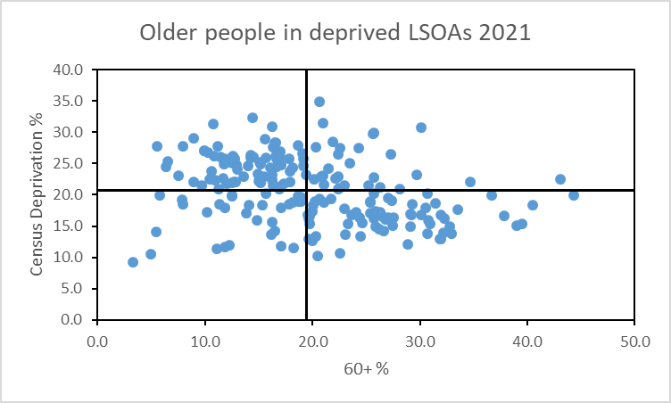
Deprivation
The 2019 Index of Multiple Deprivation included an extra domain: Income Deprivation affecting Older People Index (IDAOPI).
Doncaster is the 85th most deprived local authority in England, out of a total of 317 authorities in this category.
The average deprivation score derived from the Census deprivation measure was 20.7%.
There are 29 LSOAs* that are both deprived and have a high proportion of people aged 65+.
10,548 people age 65+ live in these areas
as demonstrated in the top right quarter of the graph below.
The IDAOPI is measured at LSOA level.
54.3% of people aged 60+ are in the nationally defined most deprived areas in the country
*LSOAs are a Census geography each LSOA has, on average around 1,550 residents. There are 199 LSOAs in Doncaster.

Slide 6
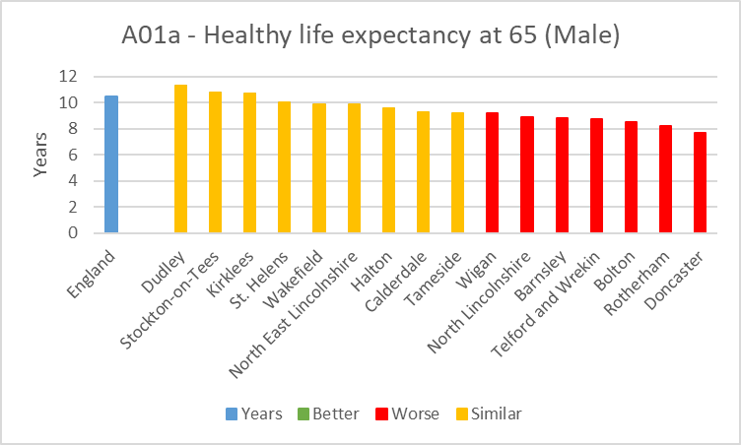
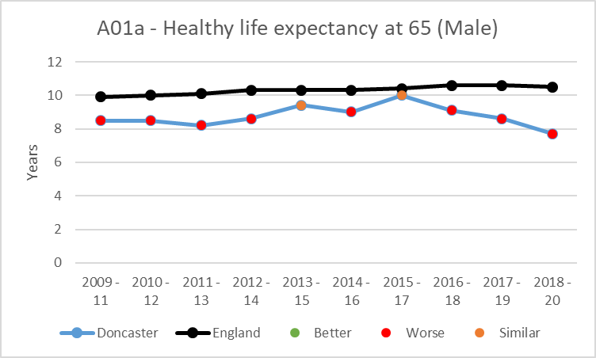
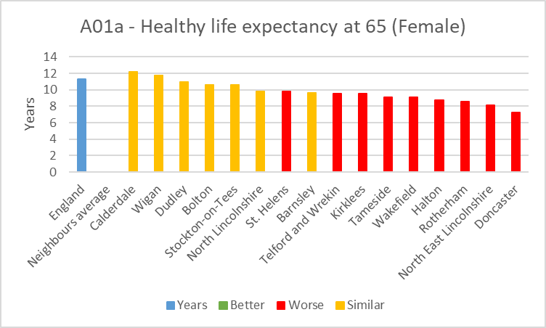
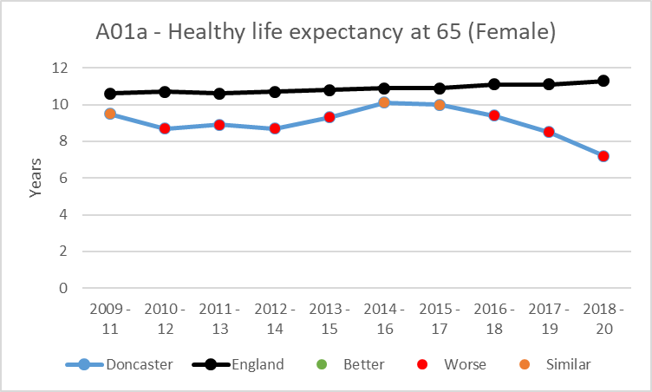
Healthy life expectancy at 65
Health life expectancy in Doncaster has been lower than the national average for several years.
Over the last 4 years HLE has been falling for both men and women.
In the period 2018-20 it fell below 8 years for those aged 65 in both men and women.
Doncaster has the Lowest Healthy Life Expectancy for those aged 65 of all its statistical neighbours.

Slide 7
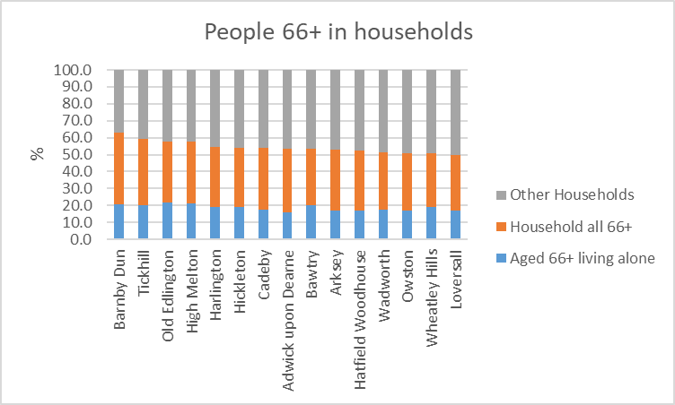
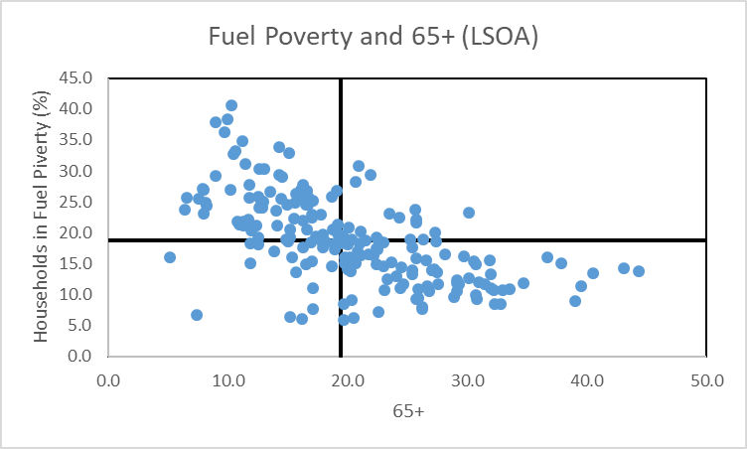
Households
The 2021 Census recorded 266,798 households* in Doncaster.
13.5% of these have a older person (aged 66+) living alone, and 23.0% are households with all members aged 66+.
18.8% of households were living in fuel poverty in 2020. This data cannot be broken down by age.
Communities with high levels of fuel poverty and higher proportions of people aged 65+ can be identified.
18 LSOAs have high fuel poverty and high numbers of older people.
The 15 communities detailed in the above graph have 50% or more of households with people age 66+ only living in them.
59,867 people aged 65+ live in areas of high fuel poverty.
* A 'household' is defined as either one person living alone, or a group of people living at the same address and sharing both cooking facilities and a living room or dining area.

Slide 8
Unpaid Care
1 in 10 Doncaster Residents provide regular unpaid care
Caring can have a significant impact on health and wellbeing. 60% of carers report a long-term health condition or disability compared to 50% non-carers
(Carers UK analysis of GP Patient Survey 2021).
No of Doncaster residents providing unpaid care by age band (Census 2021)
Age band | Number of residents
55 to 59 | 3,795
60 to 64 | 3,320
65 to 69 | 2,330
70 to 74 | 1,925
75 to 79 | 1,255
80 to 84 | 890
85 to 89 | 425
90+ | 140
A person is a provider of unpaid care if they look after or give help or support to family members or others because of long-term physical or mental ill health or disability, or problems related to old age.
Doncaster Residents providing unpaid care by age band and hours of unpaid care (census 2021)
 | up to 9 hours |  | 10-19 hours |  | 20-34 hours |  | 35-49 hours |  | 50+ hours
Age Band | Count | % | Count | % | Count | % | Count | % | Count | %
55 to 59 | 1,290 | 5.9 | 570 | 2.6 | 385 | 1.7 | 510 | 2.3 | 1,040 | 4.7
60 to 64 | 1,055 | 5.4 | 470 | 2.4 | 350 | 1.8 | 450 | 2.3 | 995 | 5.1
65 to 69 | 565 | 3.4 | 330 | 2.0 | 245 | 1.5 | 190 | 1.1 | 1,000 | 6.0
70 to 74 | 365 | 2.2 | 235 | 1.4 | 175 | 1.1 | 100 | 0.6 | 1,050 | 6.4
75 to 79 | 180 | 1.6 | 115 | 1.0 | 100 | 0.9 | 95 | 0.8 | 765 | 6.6
80 to 84 | 115 | 1.4 | 65 | 0.8 | 65 | 0.8 | 60 | 0.7 | 585 | 7.3
85 to 89 | 45 | 0.9 | 30 | 0.6 | 30 | 0.6 | 20 | 0.4 | 300 | 6.0
90+ | 10 | 0.4 | 10 | 0.4 | 10 | 0.4 | <5 |  | 105 | 4.3
Caring comes with additional costs that can have a significant impact on carers’ finances and many carers suffer financial hardship. 44% of working-age adults who are caring for 35 hours or more a week are in poverty.
(Joseph Rowntree Foundation, UK Poverty 2022).

Slide 9
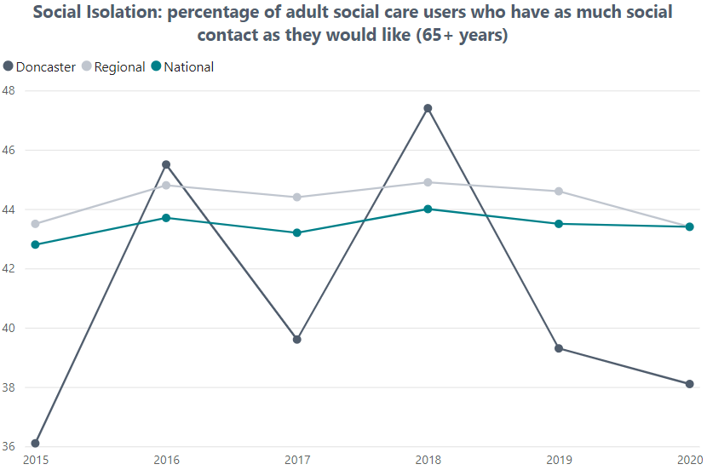
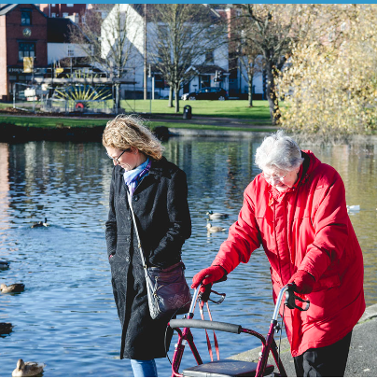
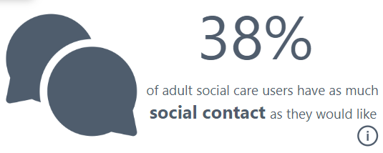
Social Isolation
‘’I can go two or three days without talking to anybody.’’
Janet, Doncaster
In 2020 38% of adult social care users (aged 65+) in Doncaster felt they had as much social contact as they would like; this is slightly below the England and Regional rates of 43% and the lowest local rate since 2015.
The proportion of respondents who completed the Social Care User Survey question "Thinking about how much contact you've had with people you like, which of the following statements best describes your social situation?", answering " I have as much social contact as I want with people I like".
There is a strong relationship between loneliness and poor mental and physical health.

Slide 10
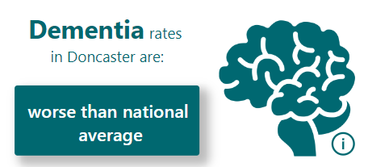
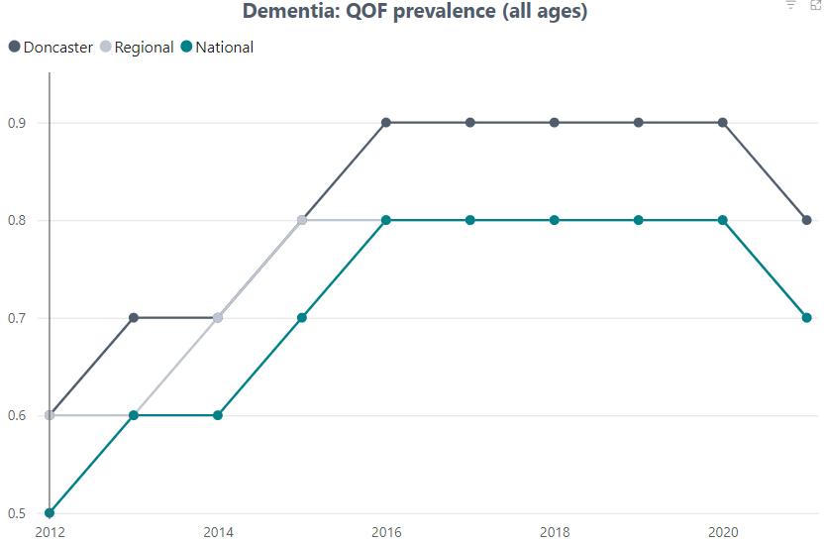
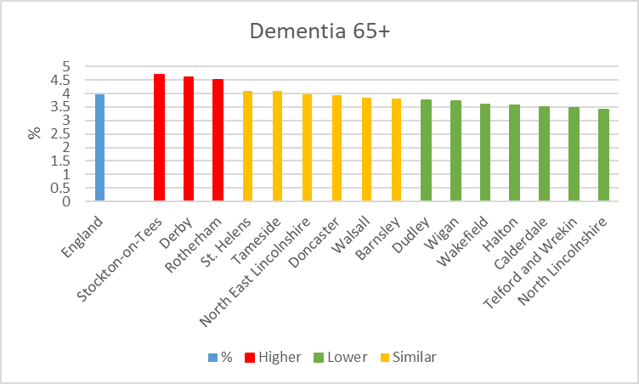
Dementia
Dementia is a syndrome characterised by a decline in intellectual function and is usually diagnosed to those in later life.
Rates of dementia in Doncaster have remained roughly stable since 2016.
Doncaster residents are similarly likely to be diagnosed with dementia than national average.
The recorded dementia prevalence is the number of people with dementia recorded on GP practice registers as a proportion of the people (all ages) registered at each GP practice. Where allocated to a local authority boundary this was done using the postcode of the practice
Doncaster has reported around 3.9% of its population aged 65+ has dementia.

Slide 11
Local Insight Summary

Slide 12
Doncaster Talks Survey
Responses
‘’We in certain areas have been deprived of our bus service. The people in lower end Norton, Old Campsall and upper Askern village. These areas cover a lot of elderly, disabled and vulnerable people and we are being cut off from life. Only a few can drive only a few can afford taxi trips so how is that fair?’’
‘’What is unfair about life in Doncaster ‘’ | % of responses
​Unfair investment by area | 18.2
​Anti-social behaviour | 10.4
​Public Transport | 10.4
Private Transport | 7.3
​Perception of Place | 6.8
​Local Govt | 6.8
Intergenerational unfairness | 5.7
‘’I am 78 years old, an Army Veteran of 22 years’ service for Queen & Country but feel let down by the Hearing Aid centre in Sandringham Road. I have been on their waiting list for new Hearing Aids & hearing test since April of last year 2021. Boots are advertising a hearing aid service at £29 per month for 4 years, that’s £1392, Unbelievable. I wrote to my GP over a month ago about my problem but have not had a reply’’
‘’Not enough provision for social activity for the elderly. Many are stuck at home, lonely and isolated. Need more day centres, disabled transport’’

Slide 13
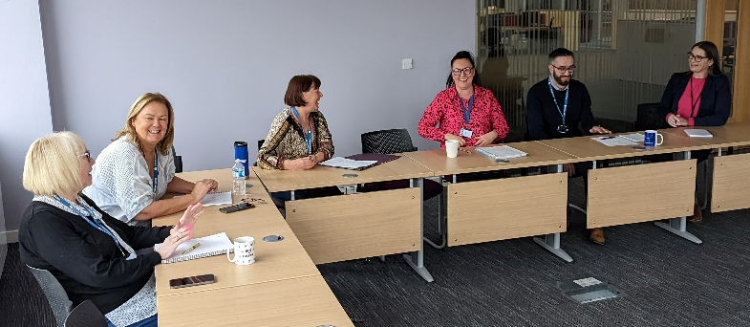
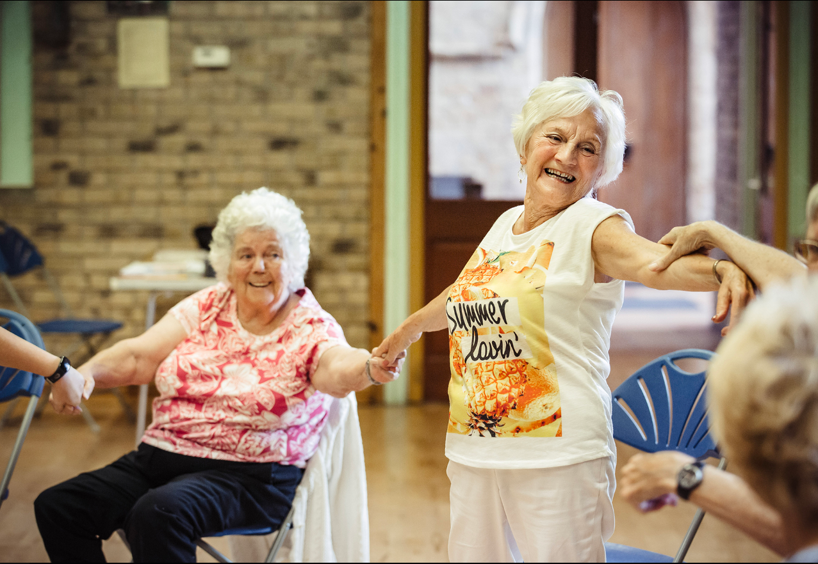
Insight from Workshops
Da
Dance On, The Point
Citizens Advice Doncaster
Three interlinking priorities for attendees of Dance On
Accessible
Transport
Access to information
Weary of digital due to scams
Won’t “google it”
Face-to-face in trusted places is effective
Challenges
Crux is often loneliness
Pandemic effect - loss of habits & confidence leading to isolation
Income maximisation: £9mn unclaimed pension credit
Pride & cautiousness means more likely to accept difficult situation
Access to information
Access to services
Transport is key barrier
Expense of day services
Safety in town centre
Community-level service delivery makes it easier
Community assets & organisation
Tipping points
Divorce
Death of a partner
Family relationship breakdown
Health issues

Slide 14
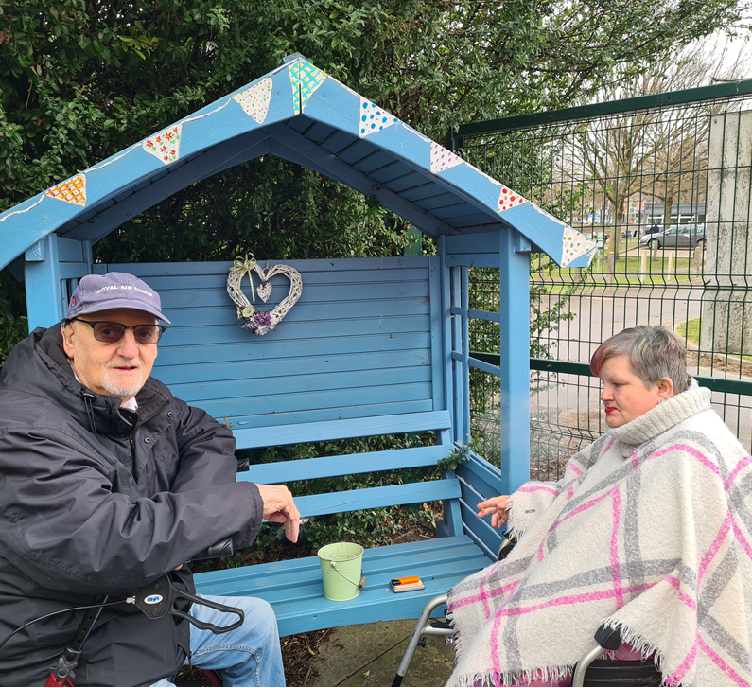
Insight from Workshops
Access to services
Limited access locally to services including banks and post offices
Increased cost of accessing services
Public Transport
Accessibility of park and rides for wheelchair users
Crime and ASB
Concern around ASB in local area and littering
Fear around speeding and road safety for pedestrians
Housing
Damp and mould issues untreated for a long period of time -> health issues
Askarne SMILE Day Centre
Live Inclusive Disability Group*
Crime and ASB
concern around safety and ASB in City Centre
disabilities/health conditions can exacerbate feelings of vulnerability.
Social Isolation
Need for social/recreational activities available through the Day Centre
Access to Services and Healthcare
access to and continuity of care
need for light touch support alongside specialist support
Transport
mixed experience of public transport
concern around bus updates for the digitally excluded
Recreation and leisure
limited social offer for the disabled beyond DICE
*Not all members of this group were older age residents

Slide 15

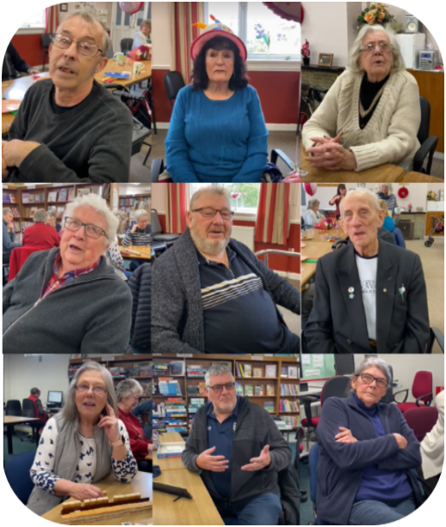
Insight from Workshops
Comments from Hatfield Community Library, Dance On, and Monday Smile a While, Thorne
‘’I try to keep myself busy since the wife died, this group has been really important in that’’
‘’We set up this bridge group after realising there were a lot of activities that catered for lonely ladies and less so for the men’’
‘’It takes 2 buses to get into town to get to the library from Hexthorpe. I’m lucky that I can get a lift from family but others are not so fortunate.’’
‘’Coming to Smile a While is my only opportunity to see people all week since my husband died’’

Slide 16
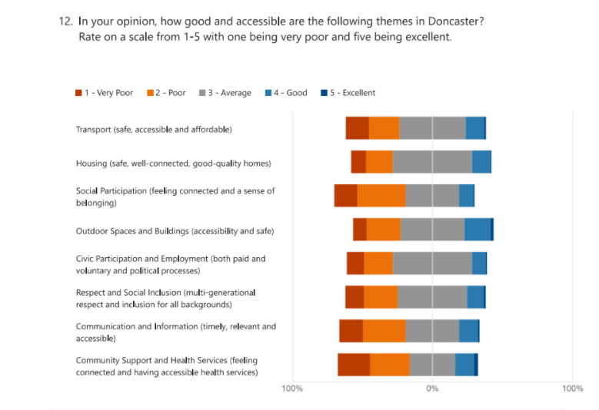
Wider Engagement
Localities Engagement 2022
Priorities for residents aged 60+ from minority ethnic backgrounds who were engaged as part of Your Life Doncaster consultation by Localities team:
  English language support
  Improved access to Services
  More frequent, better connected and affordable transport
  More opportunities to attend community groups
  More done to tackle ASB & Crime in their area
  Making local places more accessible for those with disabilities
  Cleaner streets in their area
Age Friendly Survey 2023

Slide 17
Wider Engagement
Age Friendly Festival
Autumn 2021
“When I’m older I hope that …
  … I can be healthy enough to live a healthy life, mentally and physically. Not be lonely, have enough friends to go out to do activities with and go on holidays and days out.’’
  … Elderly people will be treated as individuals with individual interests, personalities and needs. This should be understood and respected.’’
  … I can live a healthy and active lifestyle when/if I retire. I am hoping there will be access to events/activities available at any age as I grow older, to enable making friendships and trying new hobbies/skills in adult life.’’
  … There are plenty of places to go to meet up with friends and people with similar interests. That I will have enough money to live on. That medical care will be excellent and public transport will be cheap and plentiful. That I will be able to live a long, happy and healthy life and to continue to get out and do the things I like to do.’’
  … My friends and family are happy and safe. The world is a peaceful and more understanding place. That I remain confident to go out and see people, my health is OK and I’m not forgotten.’’
Dementia Insight
Healthwatch 2022
“Didn’t find anyone to help with paperwork for financial support. Asked various organisation if they could identify any activities or clubs all said they didn’t know”
“Very trying to get the care that was needed, trying to work with professionals slow. Too many different departments”
“It was getting someone to take me seriously because I could tell things weren’t right”
“It needs to holistic to the individual. My mother can’t cope with everything and sort through forms and paperwork. Way too much paperwork information, not even relevant. The cost. If people cant afford the services of day care. Befriender, they are stuck at home with unable to see anyone.”
“Transport to the day centres by St Leger is invaluable but unreliable . Despite paying for a full day at a centre you can not get a bus early to get you there. Also they bring home early. The drivers are great but needs more and better offer.”

